Slide 1
Digital Filtering
Pole-zero mapping
Hold equivalents
  Zero-order hold
  Triangle hold

Slide 2
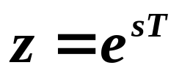
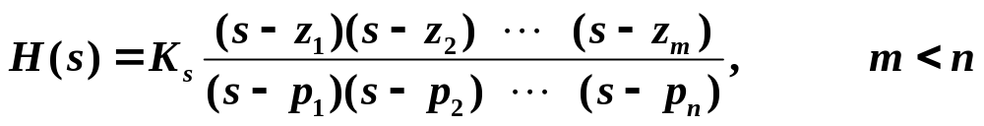
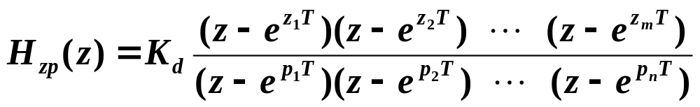
Pole-Zero Mapping
Apply to poles and zeros of transfer function H(s) to obtain an “equivalent” H(z).
Given
then
Need to know the poles and zeros of H(s).
How do we determine K_{d} ?
How do we map zeros at infinity?

Slide 3
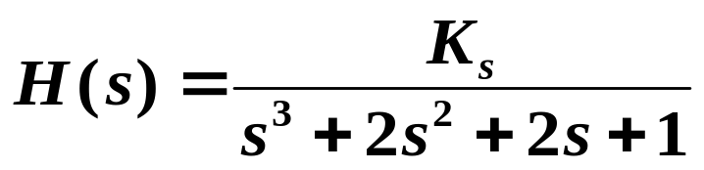
Solutions:
Choose K_{d} to match gains at some frequency of interest.
How about mapping zeros at infinity to zeros at infinity?
Example:

Slide 4


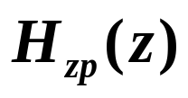
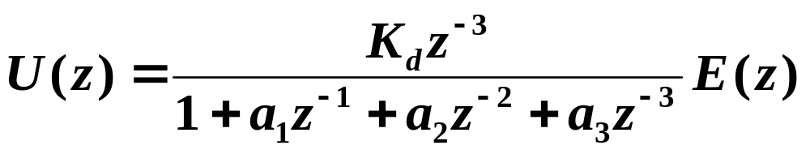

Slide 5
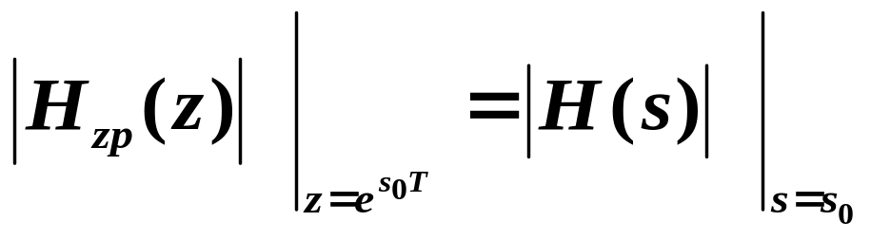
Summary of Pole-Zero Mapping
Map finite poles and zeros of H(s) with
Map all but one of the zeros of H(s) at infinity to z = -1. Map one zero of H(s) at infinity to infinity.
Determine K_{d} to match gains at some frequency of interest. (Often, DC gains are matched.)

Slide 6
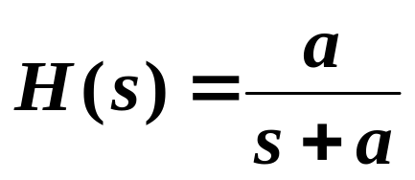
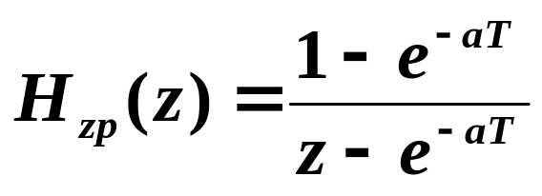
Example

Slide 7
















Hold Equivalents
Hold
Want to approximate H(s) with an H(z) such that approximates u(t) if e(k) are samples of e(t).
Idea of Hold Equivalents is to construct from samples e(k), then apply to the system H(s) to get , then sample to arrive at , and we would like that
If e(t) is bandlimited:
can perfectly reconstruct from samples e(k) .

Slide 8






Hold Equivalents to Find D(z) to Approximate D(s)
Σ
Σ
D/A
A/D
“Hold” for D/A must be practically implementable.
Here, hold equivalent is just a way of finding D(z). If “hold” is non-causal but D(z) is causal, that’s fine!

Slide 9
Zero-Order Hold (ZOH)
Most common hold
Determining H(z) is exactly the same as we discussed earlier in the term:

Slide 10
Triangle Hold
TRI(s)

Slide 11
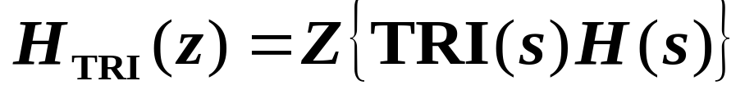
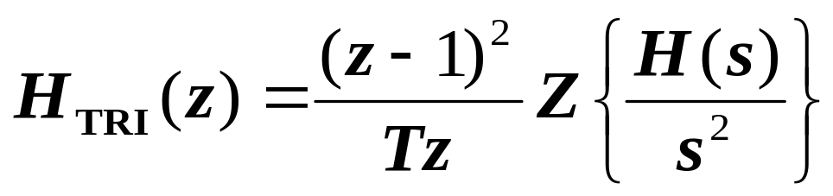
See Figure 6.9 of text.

